Slide 1

Cloud - Technical Assignment
Sabarinathan Prasanna Kumar

Slide 2
Executive Summary
Setup a GCP VM with RHEL as the OS
Install gcloud CLI in local machine and establish SSH connection to the VM
Download the AAP tar file and install it in the VM through the Containerized setup
Configure the AAP inventory file
Configure Firewall setting in VM
Access and test AAP in the browser from local machine using the default demo job
Install Prometheus as a container
Install Grafana as a container
Install Node_Exporter to collect host VM metrics
Configure Prometheus scrape jobs to get metrics from Node_Exporter
Connect Prometheus as the Data Source in Grafana
Create Dashboard in Grafana by importing pre-built dashboards for Node_Exporter data
Monitor VM performance using the Dashboards

Slide 3
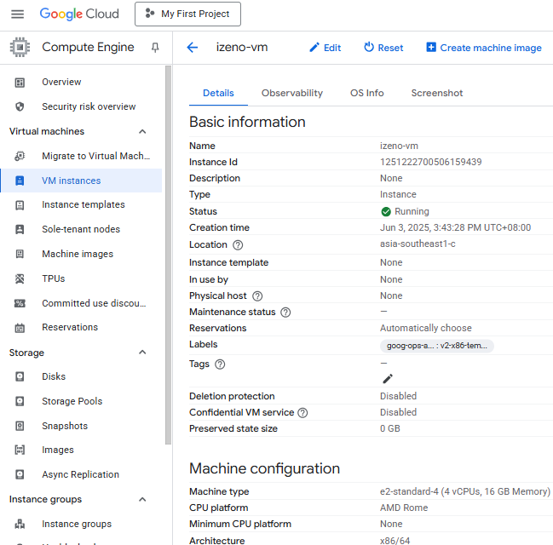
VM Setup
Key Considerations
OS major version as RHEL 9 as mandated by AAP 2.5 Containerized setup
Memory at a minimum of 16GB
4 vCPU for faster processing
Location as Southeast Asia for better throughput

Slide 4
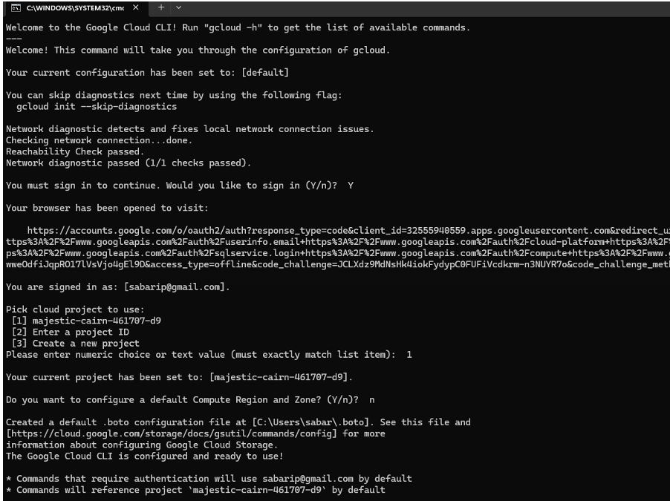
gcloud CLI
Install gcloud CLI in remote computer
gcloud CLI is used to SSH into the VM from a remote computer
Helps in running commands and monitoring their outcomes
GCP also provides SSH-in-browser to interact with the VM
gcloud CLI helps in provides VM with direct access to artifacts in the remote computer

Slide 5
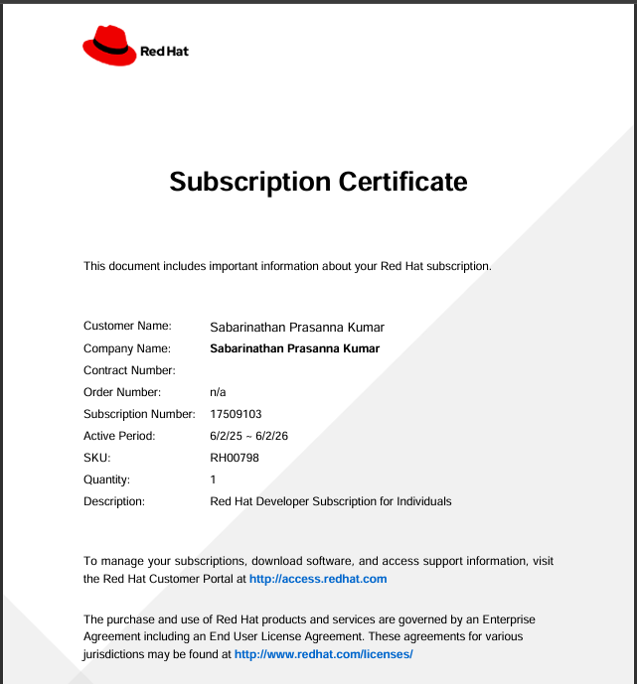
RHEL Individual Developer Subscription
Great for learning RHEL, testing automation, and exploring Red Hat technologies.
Register for Developer subscription in the Red Hat Customer portal
Validity is 1 year and entitlement is 16 systems
Required to download installation files from Red Hat official website
Great for learning RHEL, testing automation, and exploring Red Hat technologies.

Slide 6
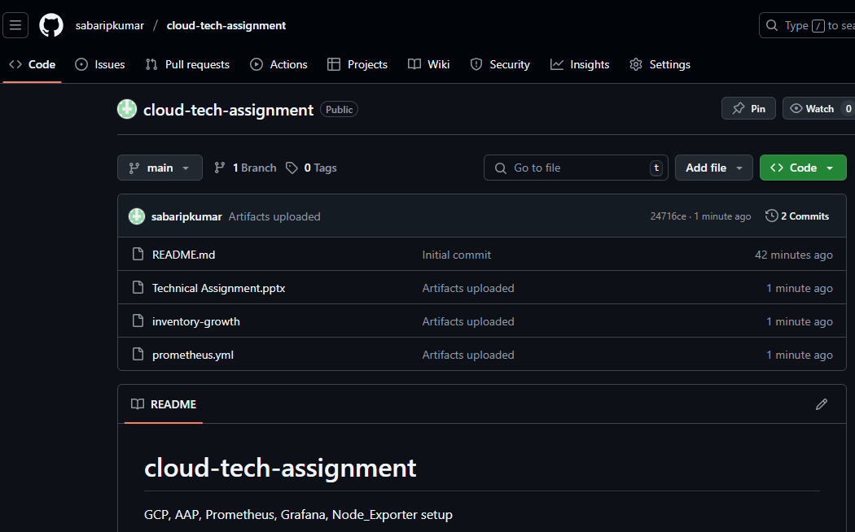
GitHub Repository
Create a repository to store and version control artifacts related to this assignment
To restrict access, create it as a private repository and provide access to selected GitHub accounts as required
Readme file provides background about the project and details about the artifacts stored

Slide 7
Ansible Automation Platform(AAP) Installation
Preferred method of installation is Single Machine, All-In-One, Containerized Setup
As the VM is headless, download ansible-automation-platform-containerized-setup-2.5-14.tar.gz file from redhat.com in the local computer
Move it from local computer to the VM using scp command
Untar the content into an installation folder that is owned by a dedicated non-root user meant for managing AAP
Among other things, this process will create Ansible collections and Playbooks needed for installing AAP
Register in redhat.com to access the redhat registry that contains the container images needed for installation
Configure inventory-growth config file by providing details of the host, dedicated non-root user, registry and other credentials needed for running Automation Gateway, Controller, Hub, EDA and Database
Run the command ansible-playbook -i inventory-growth ansible.containerized_installer.install to install

Slide 8
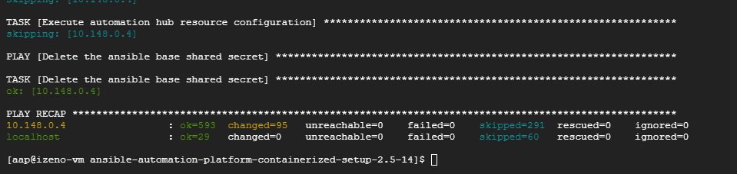
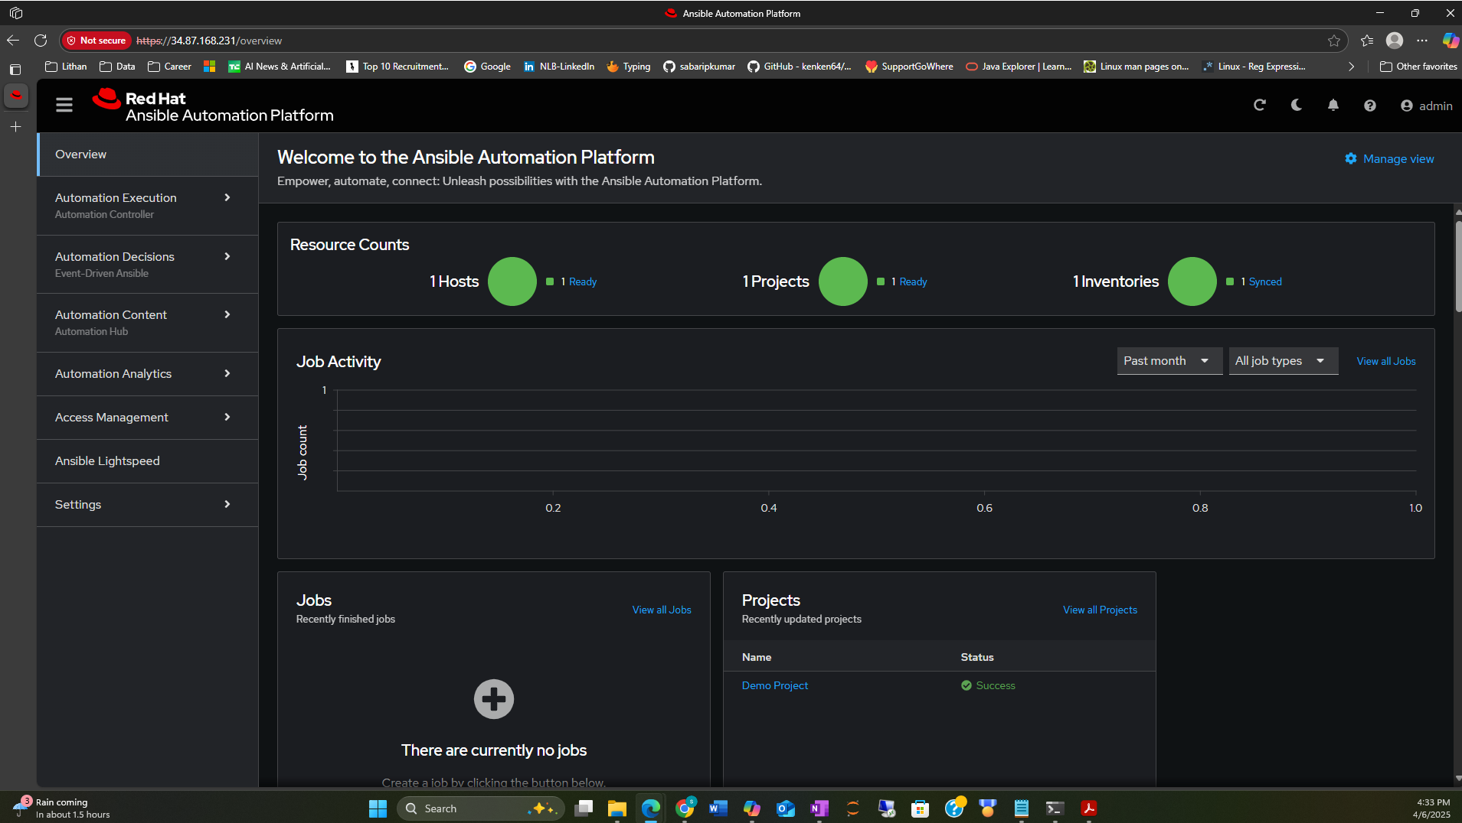
AAP – Installation
Successfully installed with no errors
To access AAP after installation, the Red Hat Subscription was activated and its manifest provided as supporting artifact
Access AAP using the browser in remote computer by providing External IP or DNS name

Slide 9
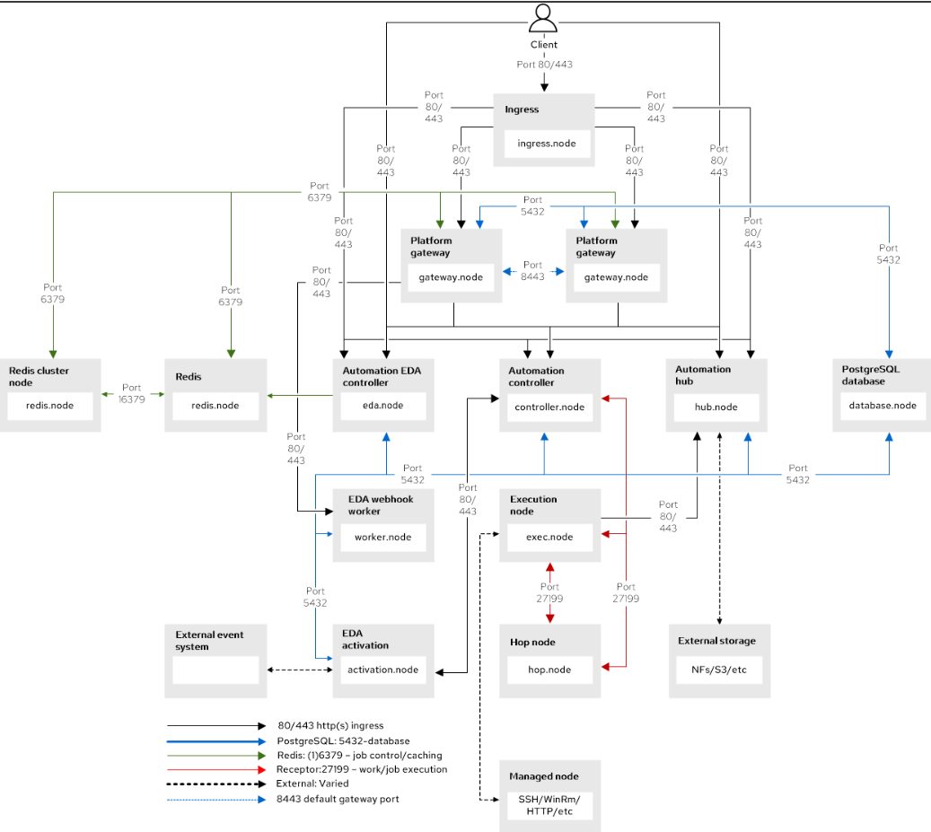
AAP Network Topology
Source: redhat.com

Slide 10
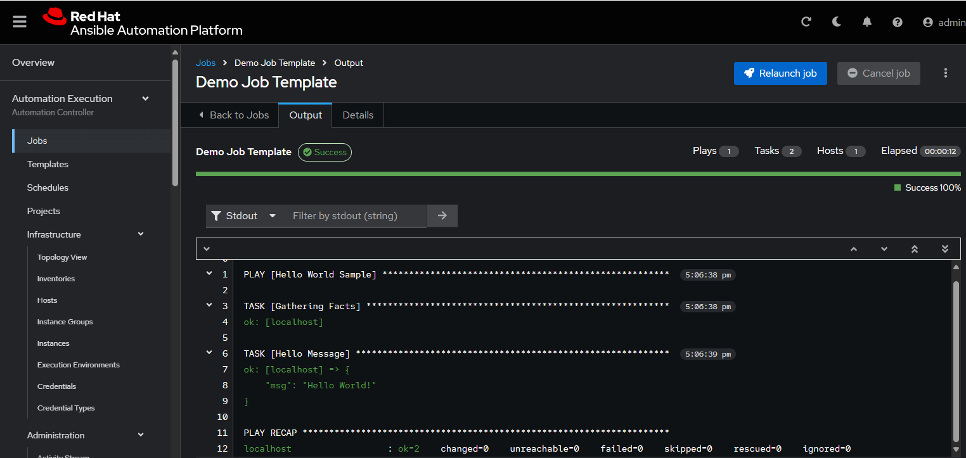
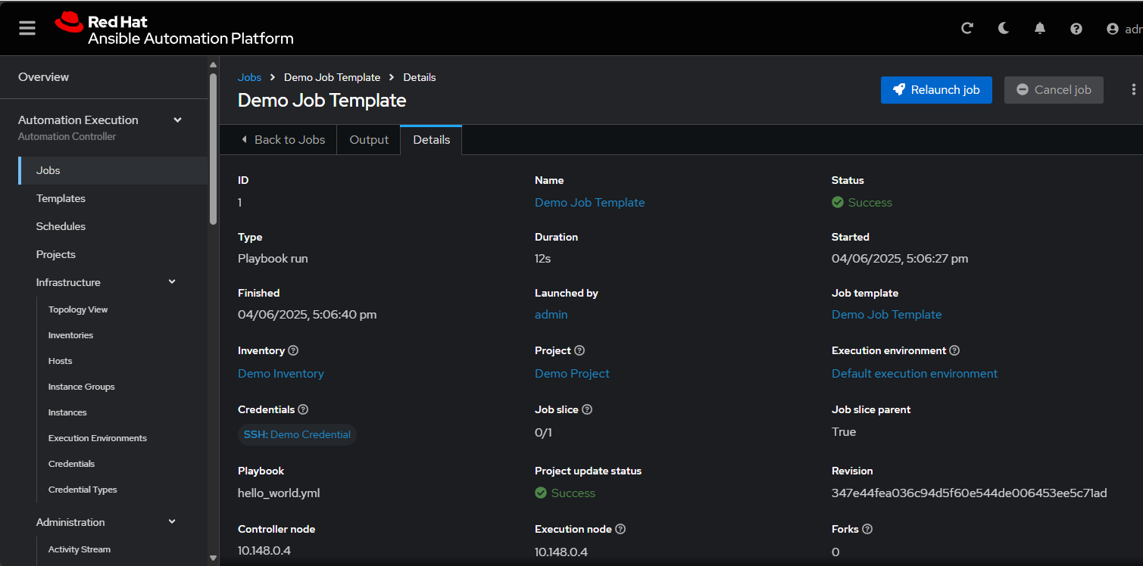
AAP Testing
Run the sample AAP playbook and capture the log

Slide 11
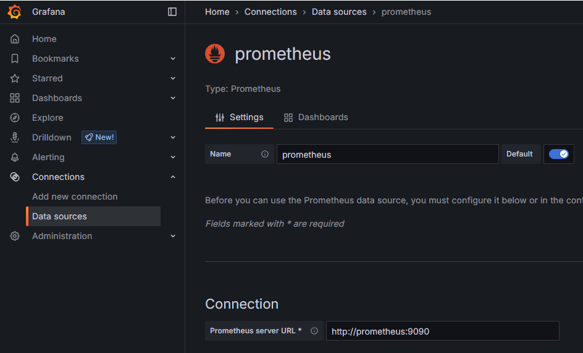
Prometheus, Grafana & Node_Exporter Installation
Installed Prometheus, Grafana and Node_Exporter as Containers sharing the same Network
Configured Prometheus.yml file with jobs to scrape itself and Node_exporter for metrics
Connected Prometheus as the Data Source for Grafana

Slide 12
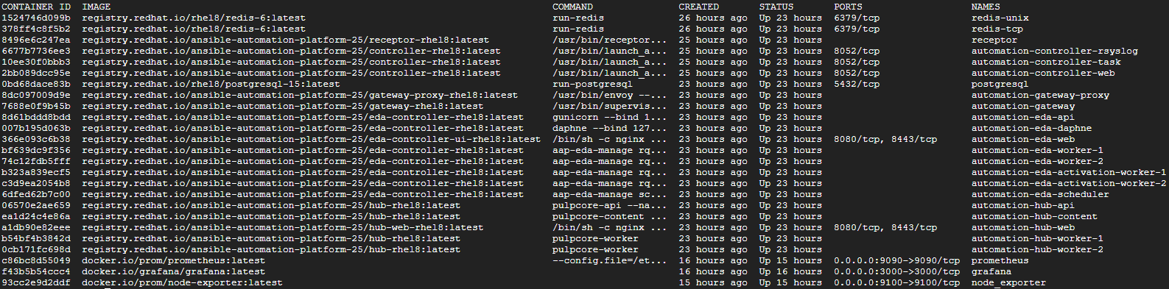
Prometheus, Grafana & Node_Exporter Installation
List of all containers running

Slide 13
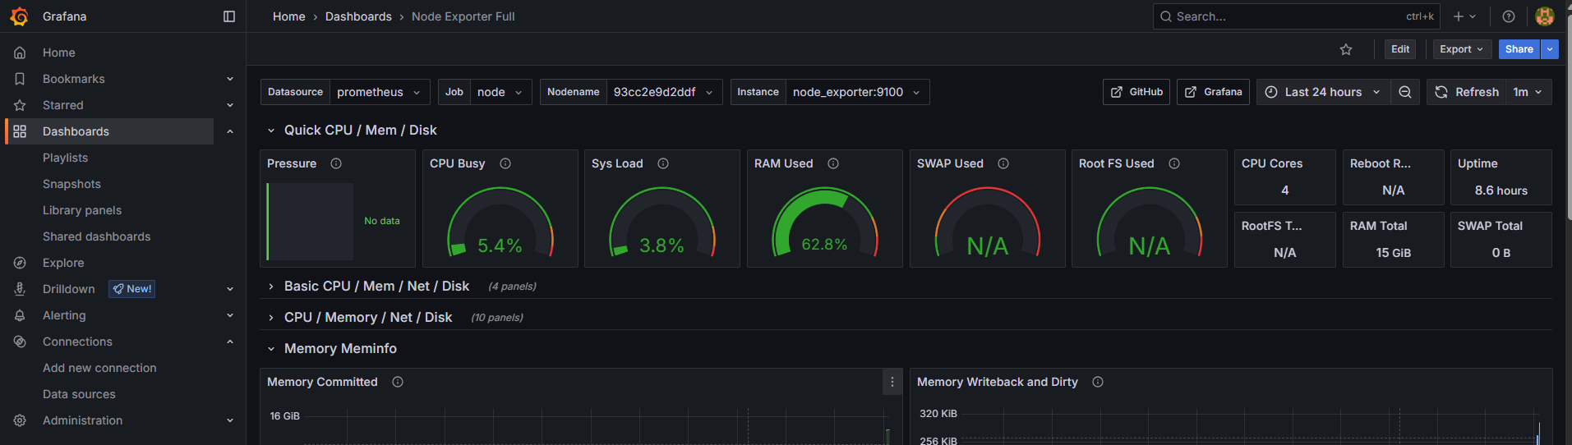
Dashboard Creation
With Node_Exporter metrics as data, created dashboards using prebuilt charts(ID:1860) provided by Grafana to monitor basic metrics like Disk, CPU, Memory, etc

Slide 14
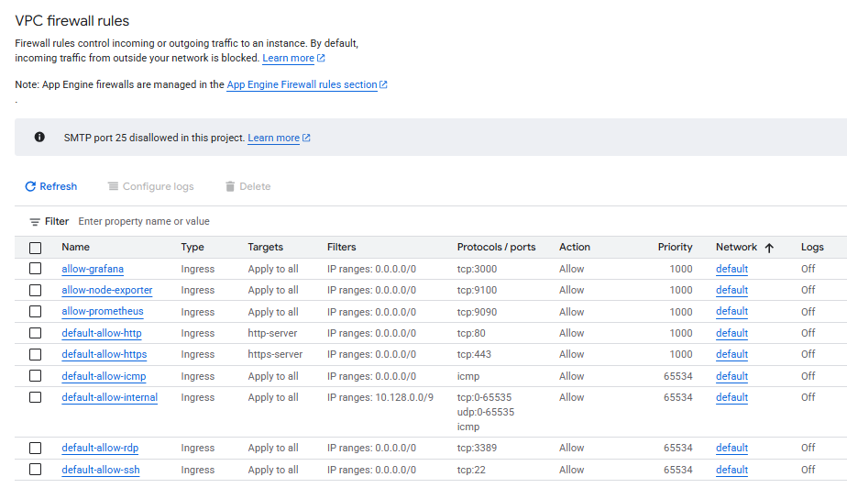
Firewall Rules
Listing of firewall rules post installation of all applications

Slide 15

Thank You

